Slide 1
WATERFALL MODEL
TEAM MEMBERS
AISHWARYA
DEEPIKA
SHYAM
MARIYA
VINAY

Slide 2
INTRODUCTION
Winston Royce introduced the Waterfall Model in 1970.
The Waterfall Model was the first Process Model to be introduced
It is very simple to understand and use.
Waterfall model works in a linear sequential flow, so it is also referred as linear-sequential life cycle model.

Slide 3
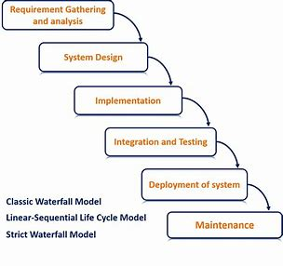
WATER FALL METHOD

Slide 4
REQUIREMENT SPECIFICATION
Requirement Gathering and analysis − All possible requirements of the system to be developed are captured in this phase and documented in a requirement specification document.

Slide 5
SYSTEM DESIGN
The requirement specifications from first phase are studied in this phase and the system design is prepared. This system design helps in specifying hardware and system requirements and helps in defining the overall system architecture.

Slide 6
IMPLEMENTATION
With inputs from the system design, the system is first developed in small programs called units, which are integrated in the next phase. Each unit is developed and tested for its functionality, which is referred to as Unit Testing.

Slide 7
INTEGRATION AND TESTING
All the units developed in the implementation phase are integrated into a system after testing of each unit. Post integration the entire system is tested for any faults and failures.

Slide 8
DEPLOYMENT
Once the functional and non-functional testing is done; the product is deployed in the customer environment or released into the market.

Slide 9
MAINTENANCE
here are some issues which come up in the client environment. To fix those issues, patches are released. Also to enhance the product some better versions are released. Maintenance is done to deliver these changes in the customer environment.

Slide 10
MERITS
Quality of the product will be good
Chances of finding the bug is less
Initial investment is less.

Slide 11
Demerits
Requirement changes are not allowed
If there is a bug , it will flow till the end of the process
Total investment is more
In waterfall model, requirement collection and design phases are not tested.

Slide 12
Project Implementation Using Waterfall Model

